Slide 1
MDT – Malt deployment toolkit
Phil Schwan
Solution Architect
Netrix LLC
Fred Bainbridge
Systems Consultant
NowMicro

Slide 2
Phil Schwan
Fred Bainbridge
@philschwan
@FredBainbridge
MCSE: Enterprise Devices & Apps, Mobility
Fantasy Baseball Champion
Almost 20 years desktop engineering
1 Year of Brewing
Running and Brewing FTW
Beer. (Not too cool for an IPA)

Slide 3
agenda
LET’S MAKE SOME BEER!

Slide 4
agenda
Why do we brew?
Brewing Basics - How does one brew?
Advanced Brewing – How do I take it to the next level?
Tips and Tricks

Slide 5
“This is actually good”
-People who drink your homebrew

Slide 6
Getting started - WHY
Why brew your own beer?
Satisfaction of doing it yourself
Can be simple or complicated
Ample opportunity to geek out
Can actually save you money in the long run
Process hasn’t fundamentally changed in thousands of years
Notes:
Satisfaction – The beer is that much more enjoyable when you brewed it, and it’s a lot more fun to share with your friends
Simple or Complicated – From extract SMASH to triple decoction Belgian quad aged in bourbon barrels.
Geeky – Recipe design, process documentation, automation, equipment…you can totally geek out with this hobby
Money – There’s some startup cost, and like any hobby you can really go all in and buy expensive equipment. You can also brew KBS clones for $1.50/bottle.
Timeless – If you have to step away, you can still buy good craft beer or enjoy others’ and when you have time again you can pick right back up

Slide 7
Brewing Basics
How does this all work?

Slide 8
Brewing Basics - PROCESS
How to Brew
1. Mash - Extract sugar from grain using hot water to make wort.
2. Boil – Cook for 60-90 minutes. Add hops occasionally.
3. Chill - Cool the boiled wort.
4. Pitch - Add yeast and let magic happen!
5. Store/Serve - Bottle or keg.
Notes:
Here is how you
Mash - Hot water converts the starches into sugars. Just don’t get too hot…above 170F starts to release tannins which make your beer taste bad
- (Extract is just somebody else doing this part for you and dehydrating it to fit in small packaging)
- Lots of other cool stuff can happen here (ex – using flaked oats to improve mouth feel)
Boiling sanitizes the wort and everything added to it
- Add hops early for bittering, later for aroma
Chill the wort
- Once the boiling stops, everything that comes in contact with the wort should be sanitized first!
- Rapid chill brings cold break where proteins precipitate out of wort
- Chill as quickly as possible so you can get it in your fermenter and turn the work over to the yeast
Pitch yeast and ferment
- Add a healthy amount of yeast
- For OG over 1.050, consider multiple packs or create a yeast starter
- Temperature is crucial. Too hot = high fusel alcohol, too cold = stalled/dormant
Store and serve
- At bottling, add a little sugar so the remaining yeast in suspension will create carbonation (approx. 2 weeks)
- Keg and put under pressure to force carbonation
- Keg carb then bottle from the keg!

Slide 9
Brewing Basics – METHODS
Brewing Methods
Extract – Somebody else mashes so you don’t have to
Partial Mash – Somebody else mashes, but you need something extra
Brew in a Bag – You’re impatient, have a giant pot and a spare winch laying around
All Grain – Willing to spend the extra time for the extra control
Homebrewing is typically done in 5gal/19L batches
Notes:
Extract – Base grains are mashed in bulk to create wort; wort is boiled down to syrup or dehydrated into powder. No concern for temperature.
Partial Mash – Bulk of the sugar from extract, but steeping specialty grains for color, mouth feel, etc. Small amount of grain, so temp important but not critical.
Brew in a Bag – Mash everything in a giant bag, pull out the bag and proceed with the boil. Less efficient/flexible than traditional all grain, but also faster and no sparge/transfer.
All Grain – Mash grains, stepping through temps as needed. Drain/sparge, then proceed with boil.
From the start of boil through the finished beer, all four processes are the same. From here on out, we’ll be talking mostly about All Grain brewing

Slide 10
BREWING BASICS - EQUIPMENT
Equipment Used to Brew
Basics
Mash tun – Insulated container (cooler) for holding grains at temp during mash
Boil kettle – Stock pot to boil wort
Racking cane – Siphon to transfer wort to fermentation vessel
Fermentation bucket – Usually plastic
Extras you really want
Wort chiller – Quickly cool your wort
Notes:
Mash tun – Recommend at least 10 gal capacity cooler. Easy to convert with a ball valve, a couple washers and a SS braided water line
Boil kettle – Recommend at least 8 gal for all grain, you need room to boil down to approx. 6 gal
Racking cane – Get an auto-siphon and hose. So much easier.
Fermentation bucket – Plastic is fine as long as it seals, just don’t scratch it.
Wort chiller – Immersion, counterflow, plate

Slide 11
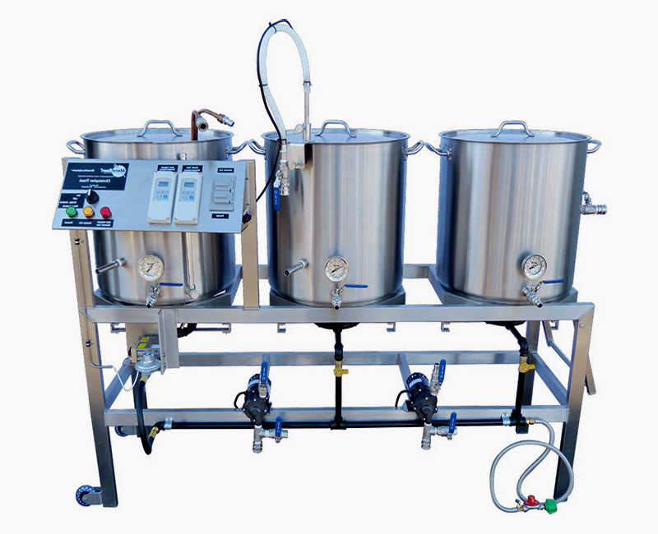
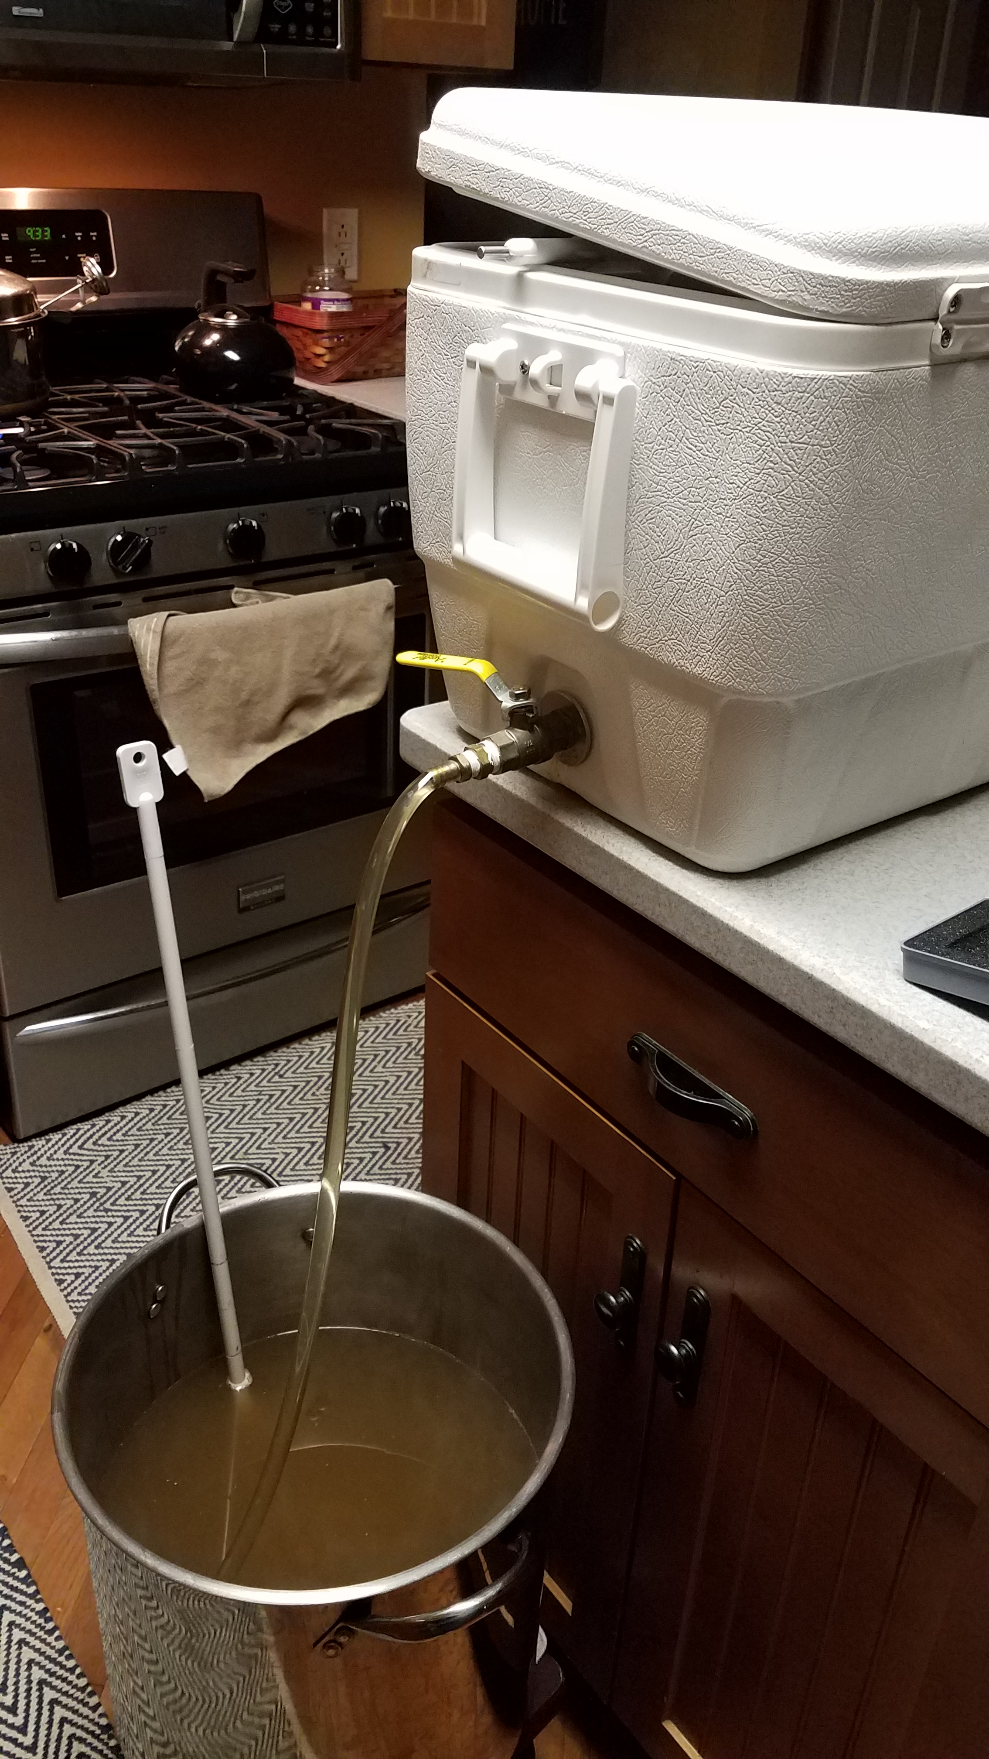
BREWING BASICS - EQUIPMENT
Equipment we want to brew with…
Equipment we actually brew with…
Notes:
Mash tun – Recommend at least 10 gal capacity cooler. Easy to convert with a ball valve, a couple washers and a SS braided water line
Boil kettle – Recommend at least 8 gal for all grain, you need room to boil down to approx. 6 gal
Racking cane – Get an auto-siphon and hose. So much easier.
Fermentation bucket – Plastic is fine as long as it seals, just don’t scratch it.
Wort chiller – Immersion, counterflow, plate

Slide 12
Getting started - Expectations
You can make good beer. It is easy. Great beer? Not so easy.
You are unlikely to save money, at least at first.
Notes:
There is a lot of hard work and precision that goes into great beers.
That sad, beer will happen as long as you’re not careless. Brewing undrinkable beer is a lot less common than you would think.

Slide 13
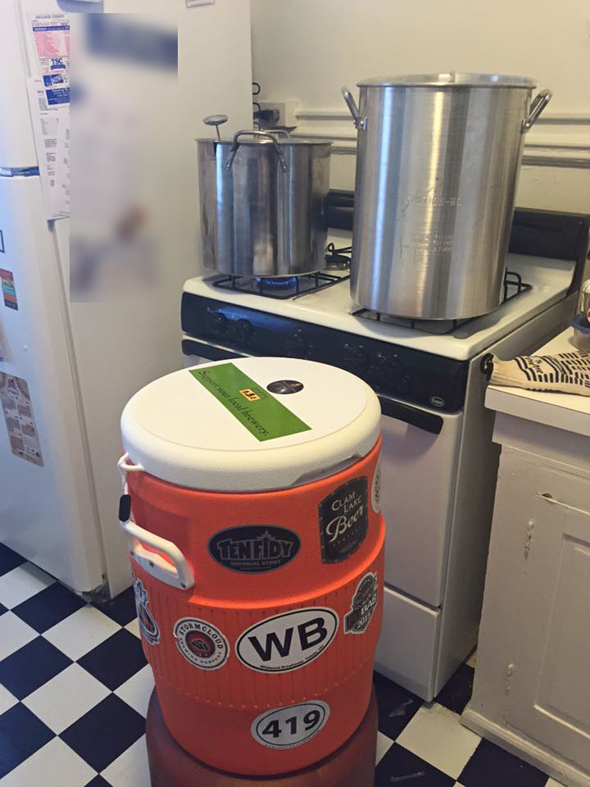
Getting started - TIPS
Don’t over do it on the equipment
Look on Craigslist for equipment!
Build your own stuff.
Keep it simple! S.M.A.S.H.
Single Malt and Single Hops
(You won’t take this advice, its ok)
Notes:
Start with simple equipment because if you don’t like brewing you haven’t lost much. Better equipment doesn’t make better beer. Good brew process makes for a better beer, good equipment makes for a comfortable / scalable brew. Easy cleanup, etc.
When building your equipment be prepared to go to your local hardware store 8-10 times. It is fun to ask for help, the staff generally get excited when they know they are helping someone brew beer.
Starting simple has a few benefits. It takes some time to get your process down as far as equipment and workspace go. Your first brews you going to be highly sensitive to your environment and process, no need to add the overhead of a complex beer recipe. Save the complexity for when you are comfortable with your workspace and equipment and you don’t have to constantly be thinking about it. That’s the time you want to start looking at making a complex beer.

Slide 14
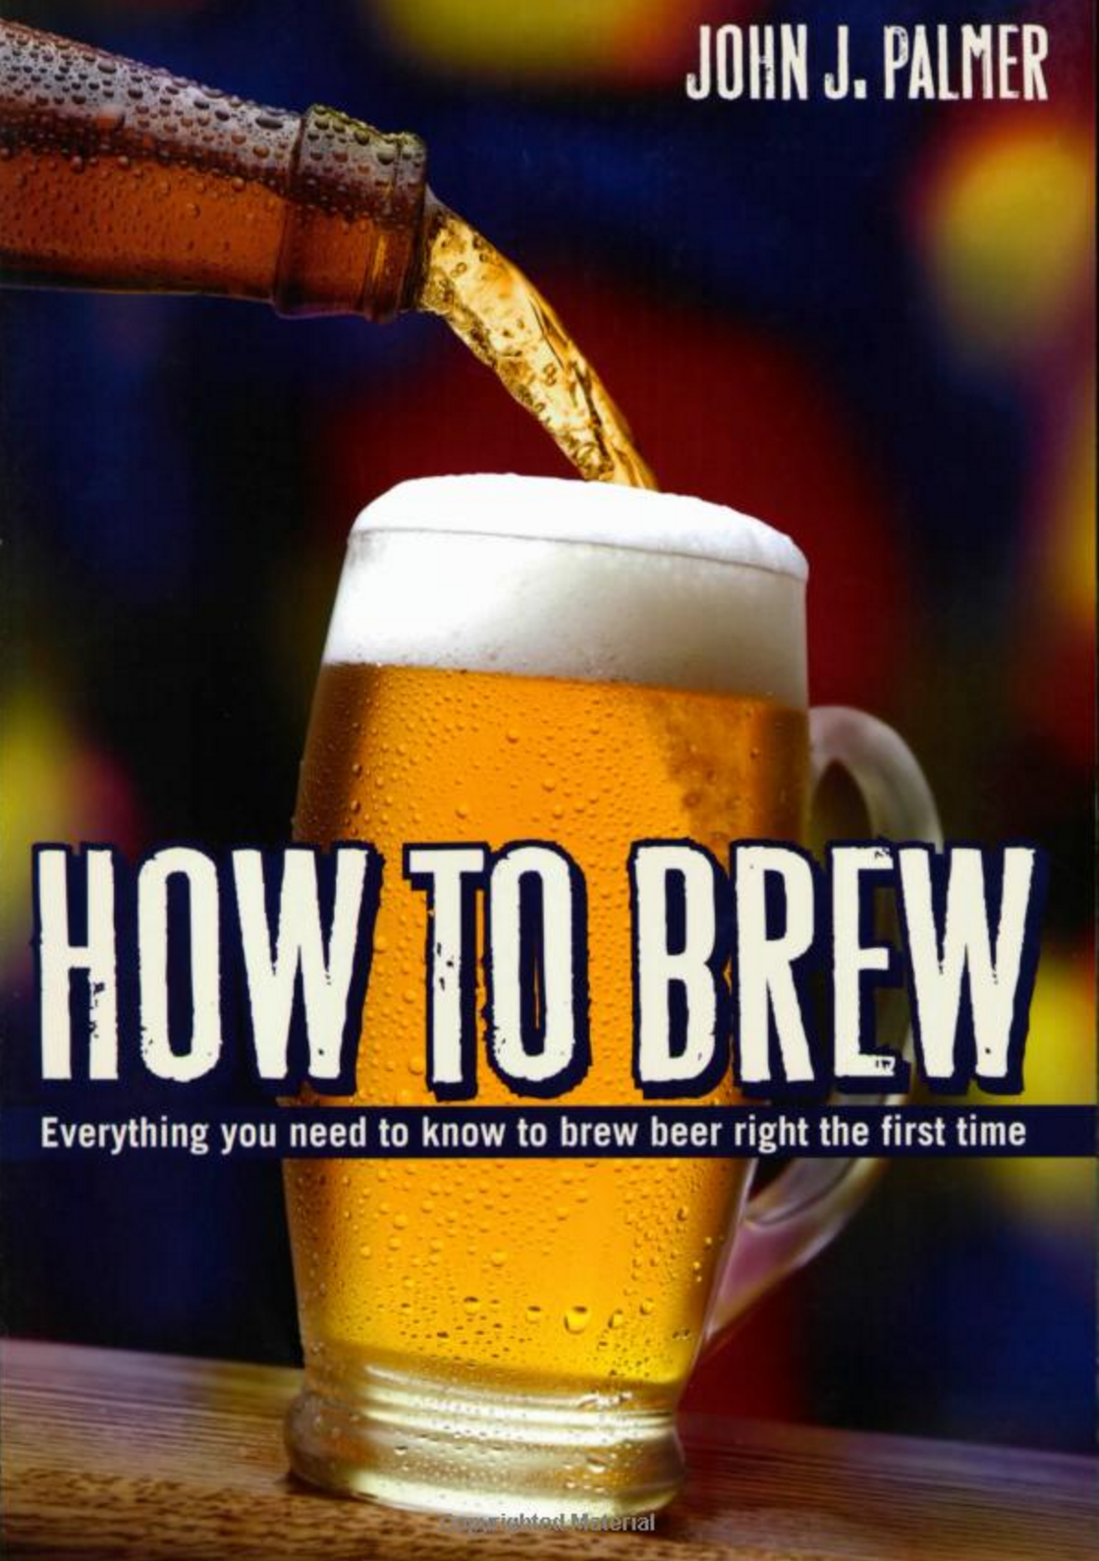
Getting started - TIPS
Read this book.
Online for free
http://howtobrew.com/
Notes:
This book is the equivalent of learn powershell in a month of lunches.

Slide 15
BREW DAY!!
It’s a great day.
Notes:
We are going to walk through a bew day in great detail here. Stopping to talking in detail about the process and equipment.

Slide 16
Brew Day Tips
Give yourself enough time.
Have patience.
Have a clean workspace.
Be Prepared.

Slide 17

The night before (WATER PREP)
Water. Your first opportunity to geek out.
Get a water report, you have to call for this
Water profile can dictate what beers you can make well.
BOOK: Water: A Comprehensive Guide for Brewers
Spring water good. Distilled water bad.
Pour the water the night before
Bypass your water softener! (unless you want a salty beer)
Chlorine tastes bad. Leave water out over night to dissipate.
Did you forget? Camden Tablets (potassium metabisulfite)
Ascorbic acid/Vitamin C to eliminate chloramines
Notes:
Some water can’t make some beers. This is a hard truth you may have to deal with.

Slide 18
The Mash (Extracting Sugar FROM GRAINS)
“Mashing is the brewer's term for the hot water steeping process which hydrates the barley, activates the malt enzymes, and converts the grain starches into fermentable sugars.”
"- John Palmer
The Equipment (Mash Tun)
[PICTURE]
How to build
Notes:
You can buy a mash tun or you can build your own. Any standard 48 quart picnic cooler will work. What you

Slide 19
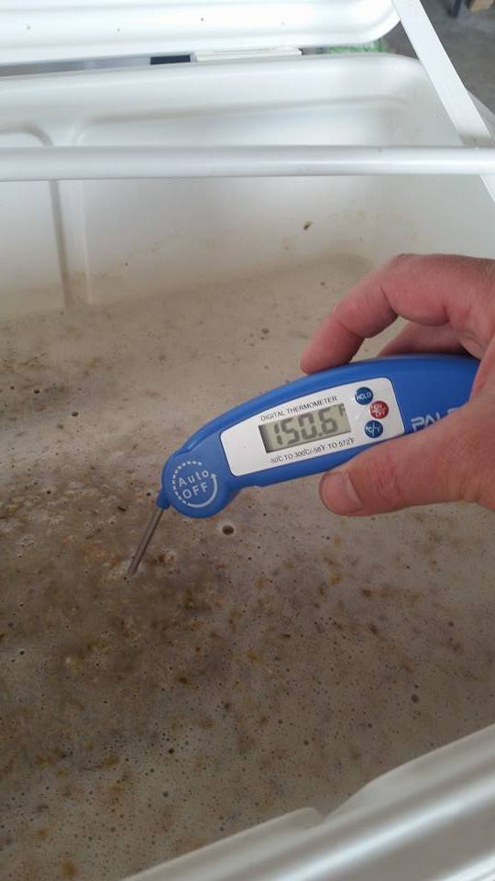
The Mash (Continued)
The goal is to get your grain soaking in water between 148-160 degrees for 60+ minutes.
Over 170 degrees will stop all enzyme reactions.
Under 140 degrees will not get the right enzymes extracted.
You don’t want the temp to drop more than 5 degrees during the mash.
A standard Coleman® cooler can do this without a problem.
Notes:
Some water can’t make some beers. This is a hard truth you may have to deal with.

Slide 20
starting The Mash - WATER
Heat the Mash Tun! (add hot water, close the lid, swish it around)
Amount of water to use (Ratio) - quarts of H20 / lbs of Grain
1.5 is fine.
Strike Temp
(.2 / RATIO) * (TargetTemp – InitialTemp) + TargetTemp
Or appx 12 degrees hotter than your desired mash temp.
To hot? Stir it up. Too Cold? Add hot water.
Notes:
Heat the mash tun so as not to loss heat when adding water. Have thermometer handy, a grill thermometer works great.

Slide 21
Adding grain to the Water
Add the grain to the water.
Check your temp and make sure you are at your desired temp.
Stir to cool, add water to heat it.
Stir up the grains gently, but thoroughly! You have to break up all the dough balls in order to get good extraction.
Have a big perforated paddle for this.
Close up the cooler and let the chemistry happen.
Notes:
If

Slide 22
Advanced Mash - PH
The desired PH level for your mash is between 5.0 and 5.6.
Depending on your water and grain this can be challenging to hit.
You can make good beer if your mash PH is off.
Every 10-15 minutes you can take a sample from the Mash tun and measure the PH and see how you are doing.
Manipulating the Mash
Grains -> Dark grains will lower your mash
Acid will lower you rmash PH
Sodium Bicarbanate will raise your mash PH.
Notes:
This is the fun stuff. If you are screwing around with this, either know your chemistry or use a tool to help you. You need an accurate water report and a decent PH tester if you want to get serious about controlling your PH.
You may be lucky and have good water and never have to worry about this. (i.e. Chicago)

Slide 23
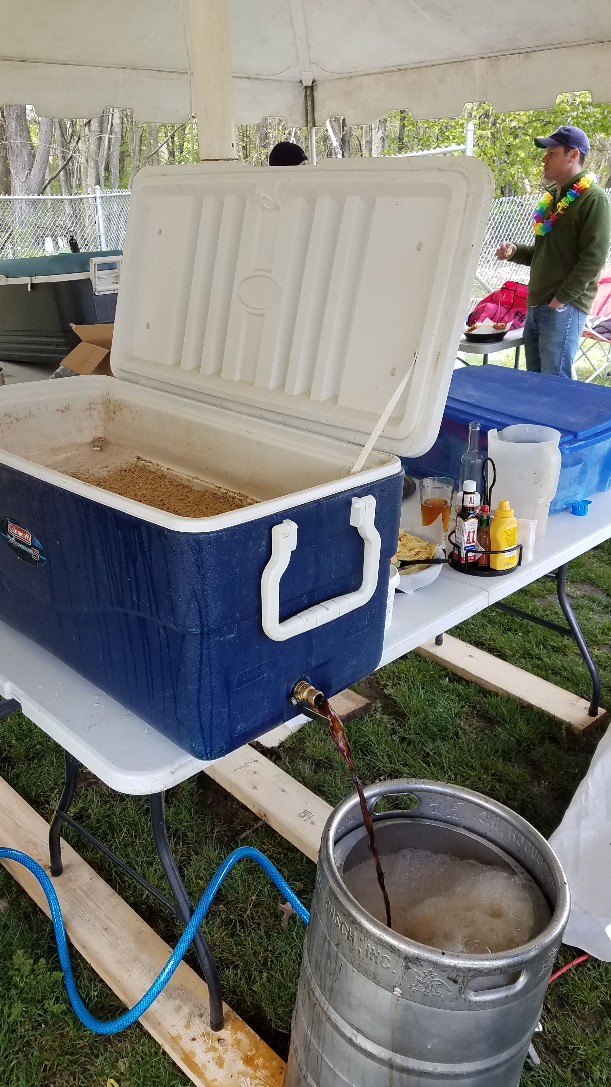
The Lauter, VerlouFing and Sparging
This is getting the wort out of our mash tun and into the boil kettle.
Equipment – Boil Kettle
Probably the most expensive piece of equipment if you buy it.
You can fashion a keg into one. (requires a propane burner)
Nice to haves –
Attached Thermometer
Size, bigger is better.
Handles / Grips
Notes:
A big boil kettle is nice to prevent boil overs and to be able to account for boil off or adding of water.

Slide 24
Extraction Percentage
The amount of sugar you extract from the grain vs. the total amount of sugar available is extraction percentage.
The sugar is what turns into alcohol.
More grain = more sugar = stronger beer
High efficiency is harder with higher gravity beers.
It’s not always about the alcohol; balance is important
Can always boost with extract or other sugar sources

Slide 25
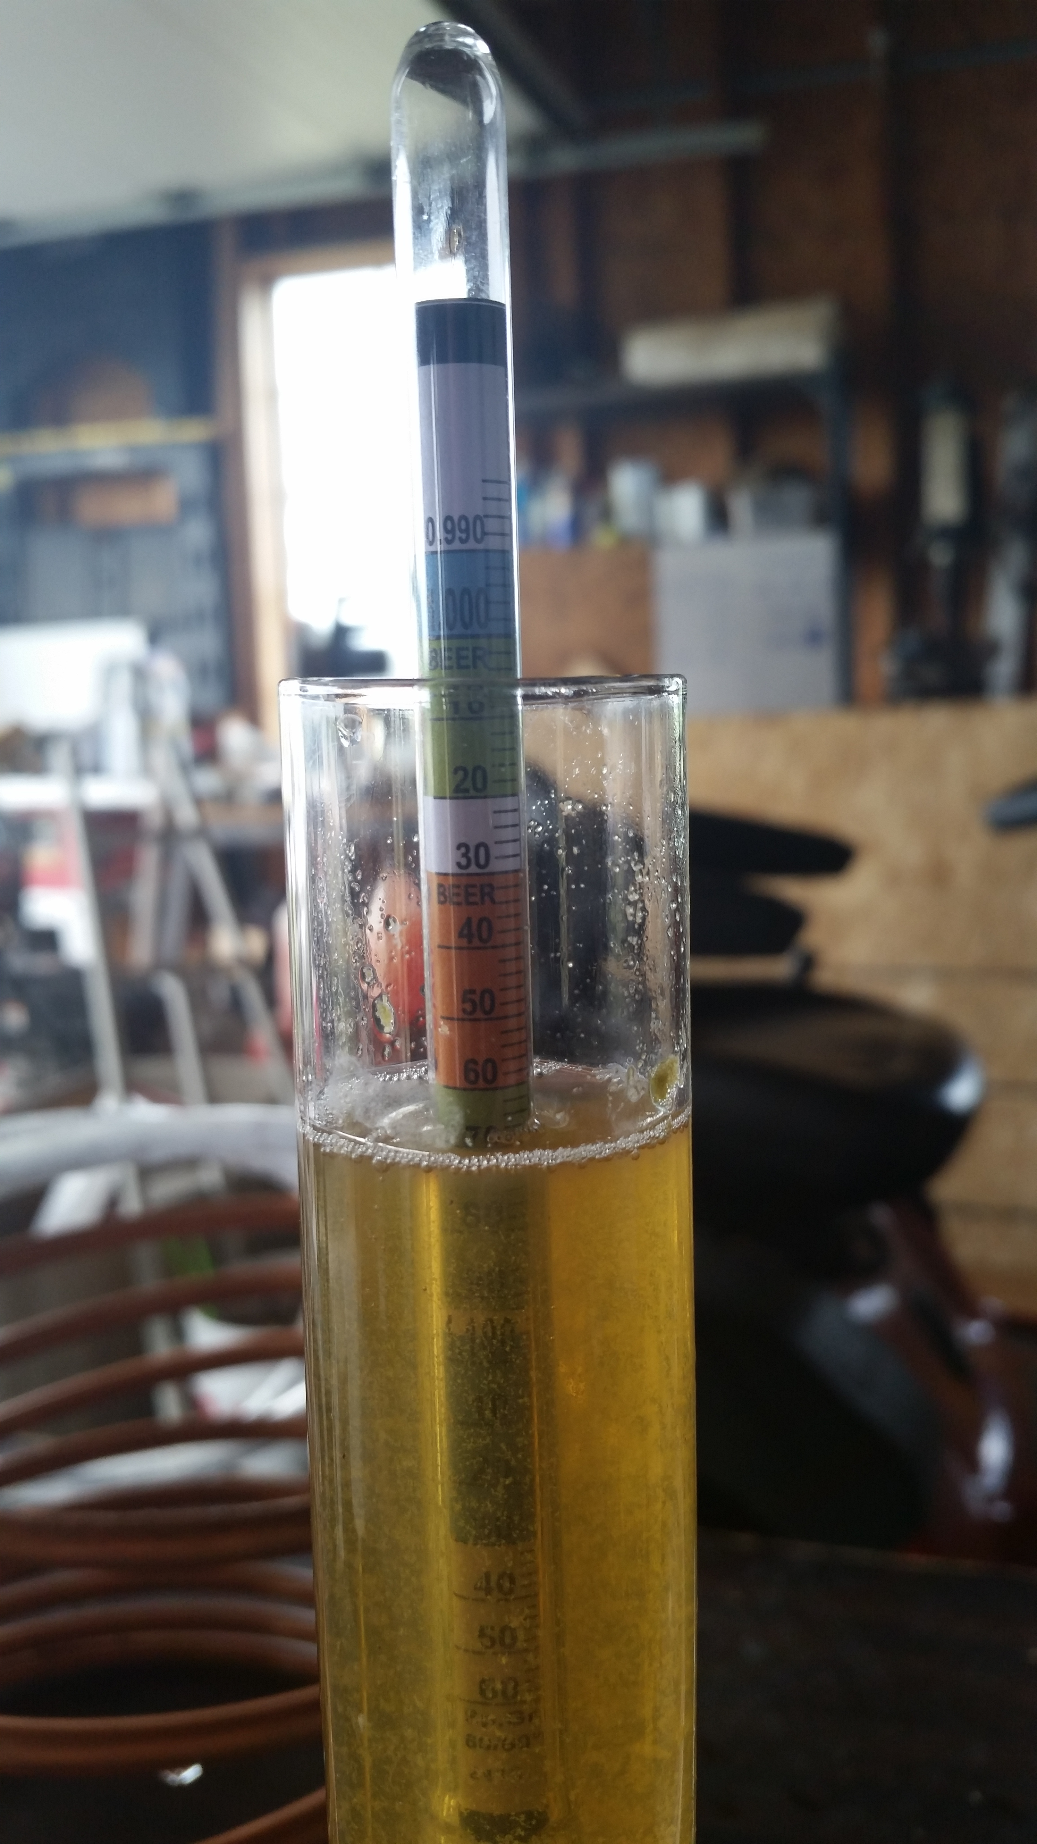
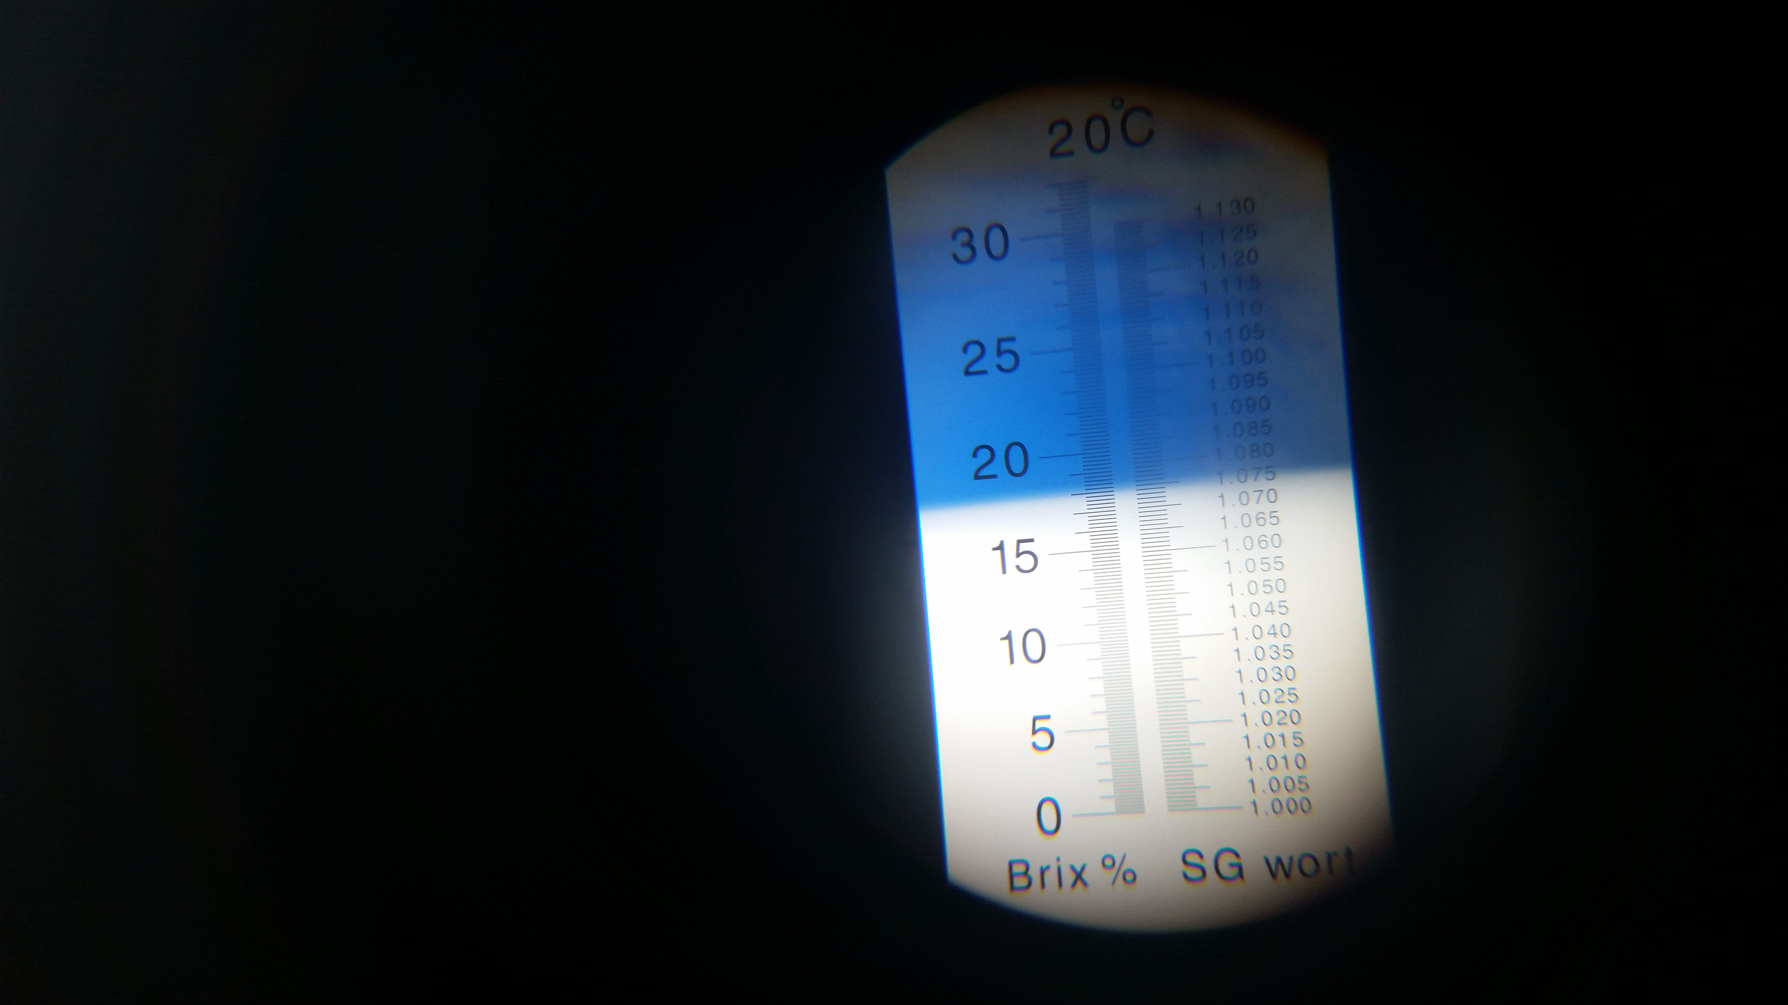
Gravity
The amount of sugar in your wort is measured based on a gravity measurement.
You measure gravity using a hydrometer or refractometer!
ABV = (Starting Gravity – Final Gravity) * 131.25

Slide 26
VerlouF
Allows the grain bed to settle and act as a natural filter
Removes grain bits and husks from the work before they reach the boil kettle

Slide 27
Basics
Water
Grain
Yeast
Fermentation

Slide 28
Prepare the water in advance.
Bypass your water softener.
Chlorine tastes bad. Leave it out over night to rid yourself of that trash.

Slide 29
Brewing Tips and Tricks
How does do I not screw this up?

Slide 30
Tips and Tricks
Learn to be consistent
Get comfortable with base styles first, then get creative
Know WHY you put each ingredient in
Brew what YOU like
Notes:
Consistency – Say what you want about Budweiser and Coors…they brew millions of gallons a year and it all tastes the same
Base – Don’t try to brew a strawberry hibiscus oatmeal cookie imperial stout as your first beer.
Ingredients – Know what you’re trying to accomplish with each ingredient. Don’t throw 4 pounds of chocolate malt in a stout; you will regret it
BREW WHAT YOU LIKE

Slide 31
Brewing Automation
IoT - Intoxication of Things?

Slide 32
Brewing Automation
You can automate some or all of the brewing process
Temperature is the most common measurement point

Slide 34


Slide 35
agenda

Slide 36
Title
Line1
Bullet Level 1
Bullet Level 2
Bullet Level 3

Slide 37
Title
Code

Slide 38
Text Only with Border
Level 1
Level 2
Level 3

Slide 39
Text Only (Red)
Level 1
Level 2
Level 3

Slide 40
Title
Text 1
Level 1
Level 2
Level 3
Text 2
Level 1
Level 2
Level 3

Slide 41
Title
Section 1
Section 2
Text
Level 1
Level 2
Level 3
Text
Level 1
Level 2
Level 3

Slide 42
Demo Title

Slide 43





























Slide 44






























Slide 45




























Slide 46




























Slide 47




























Slide 48




























Slide 49




























Slide 50























Slide 51
















